Slide 1

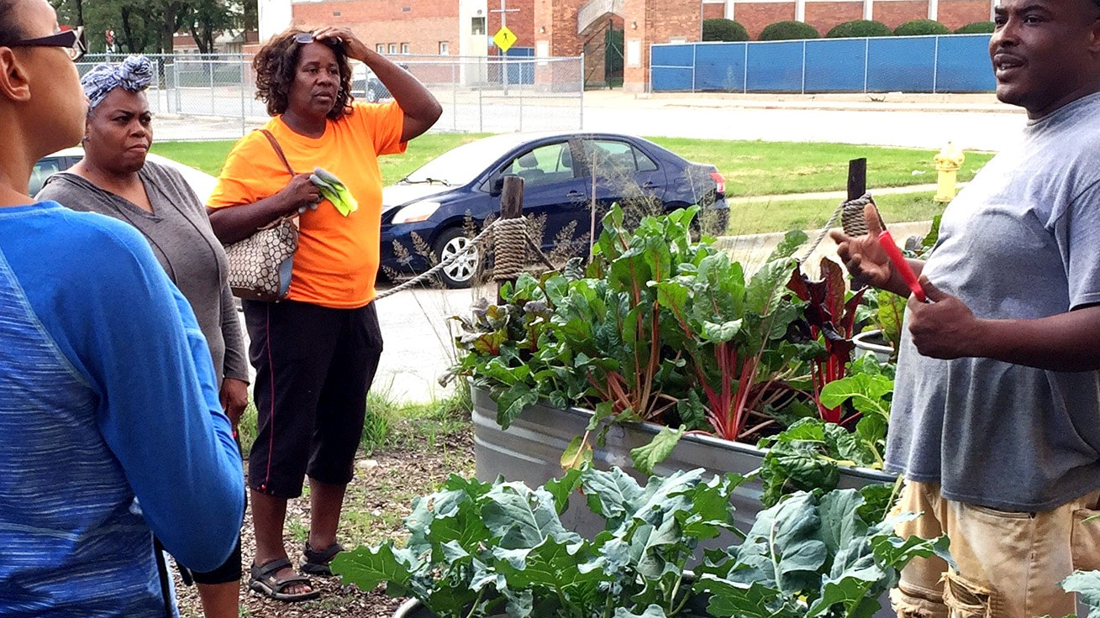
activism + analysis 4 public health equity
A partnership between Proviso Partners for Health (PP4H) and the Cook County Department of Public Health (CCDPH) to evaluate the public health impacts of community-based food access programs
Notes:
Bridging grassroots activism and epidemiology toward a public health equity. (different values, languages)

Slide 2
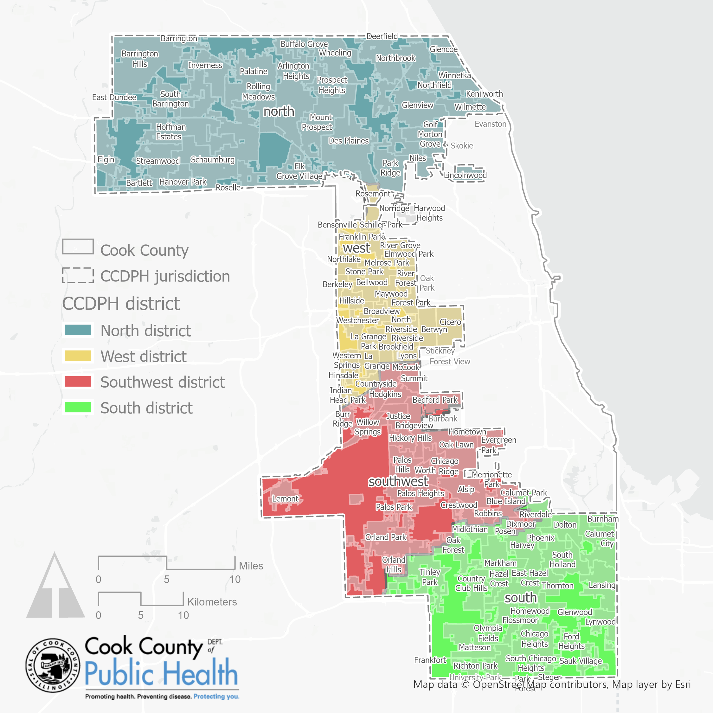
BRIDGING missions & PLACES
CCDPH
To optimize health and achieve health equity for all people and communities in suburban Cook County…
Chicago
PP4H
To build capacity and address racial, health, and economic inequities through partnerships while leveraging community assets and wisdom…
Data sources: US Census Bureau American Community Survey, 2015-2019 Table B17001, Poverty Status in the Past 12 Months by Sex by Age; TIGER/Line shapefiles, 2019

Slide 3
Complementary APPROACHES AND capacities
CCDPH
PP4H
Employs a network approach that brings together residents, partners and resources to address issues facing communities.
Because of all the epidemiological information CCDPG gathers and analyzes, it is a major source of information about the priority health needs throughout suburban Cook County.
This information helps partners and the public, plan for and address emerging health threats, and promote healthy living through awareness, education, programs and community development.
Works collaboratively to implement policy, systems, and environmental change strategies that promote racial, social, and economic equity within Proviso Township.
Transforms communities through shared leadership and power, innovation and social enterprise and leveraging resources and assets.
Envisions a community that encourages and supports healthy eating, active living, and economic opportunity where we live, work and play.
Notes:
wisdom/voices/power; not “competencies”; capacities

Slide 4
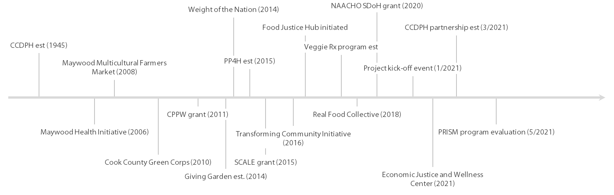
Project BACKGROUND/TIMELINE
Leveraging assets on a local scale
Leveraging assets on a national scale
Notes:
Long history between the two organizations
Long-term Collaboratorsex
Add Cppw grant (2011)
Greencorps grant (2010)
Weight of the nation grant (201X)
“PP4H would not have been possible without Cook County”
Cook County in a process of transformation through these different novel partnerships
What we’ve grown into is movement building
movements: Food justice; economic justice; mental health

Slide 5
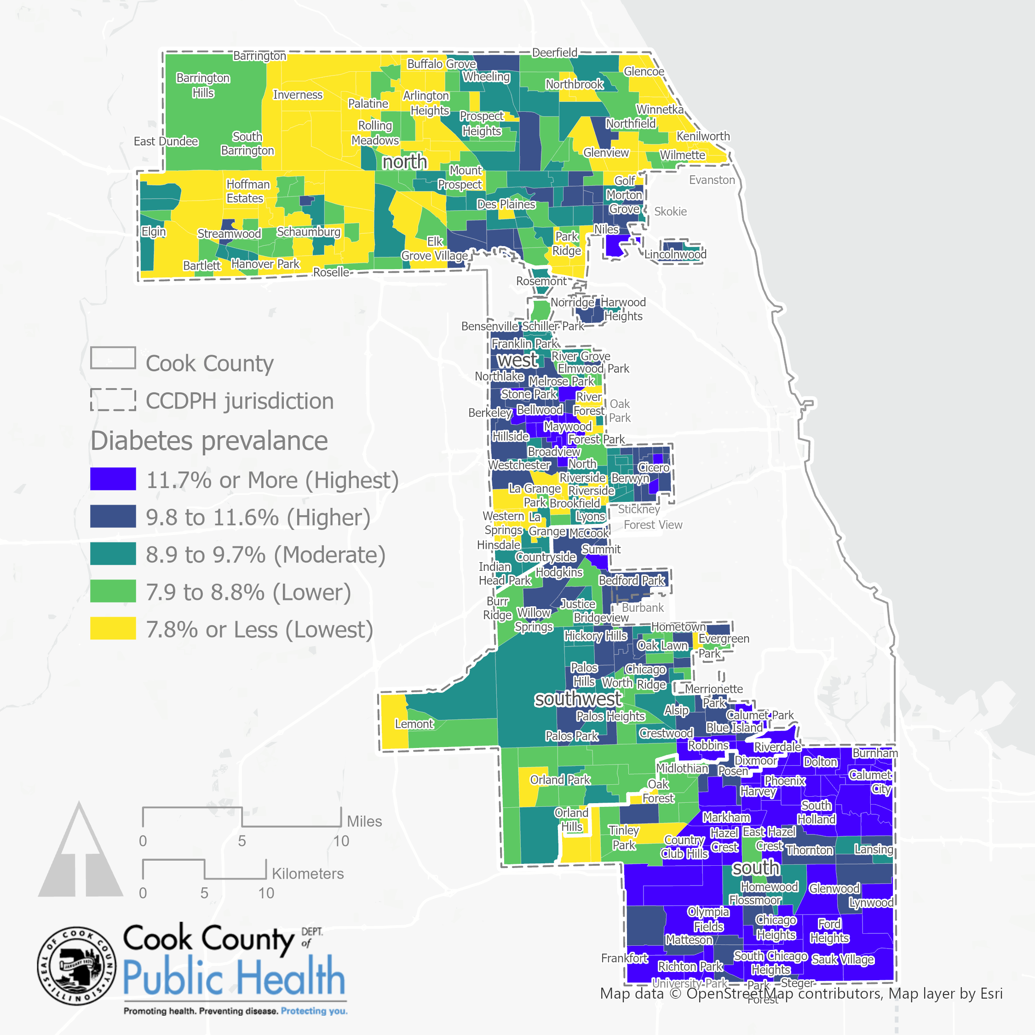
Diabetes Prevalence Estimates
This figure shows diabetes prevalence by census tract using modeled estimates from the CDC’s PLACES dataset (2020).
Areas represented in dark blue indicate communities experiencing higher levels of inequity.
Data sources: CDC PLACES, 2020; TIGER/Line shapefiles, 2019

Slide 6
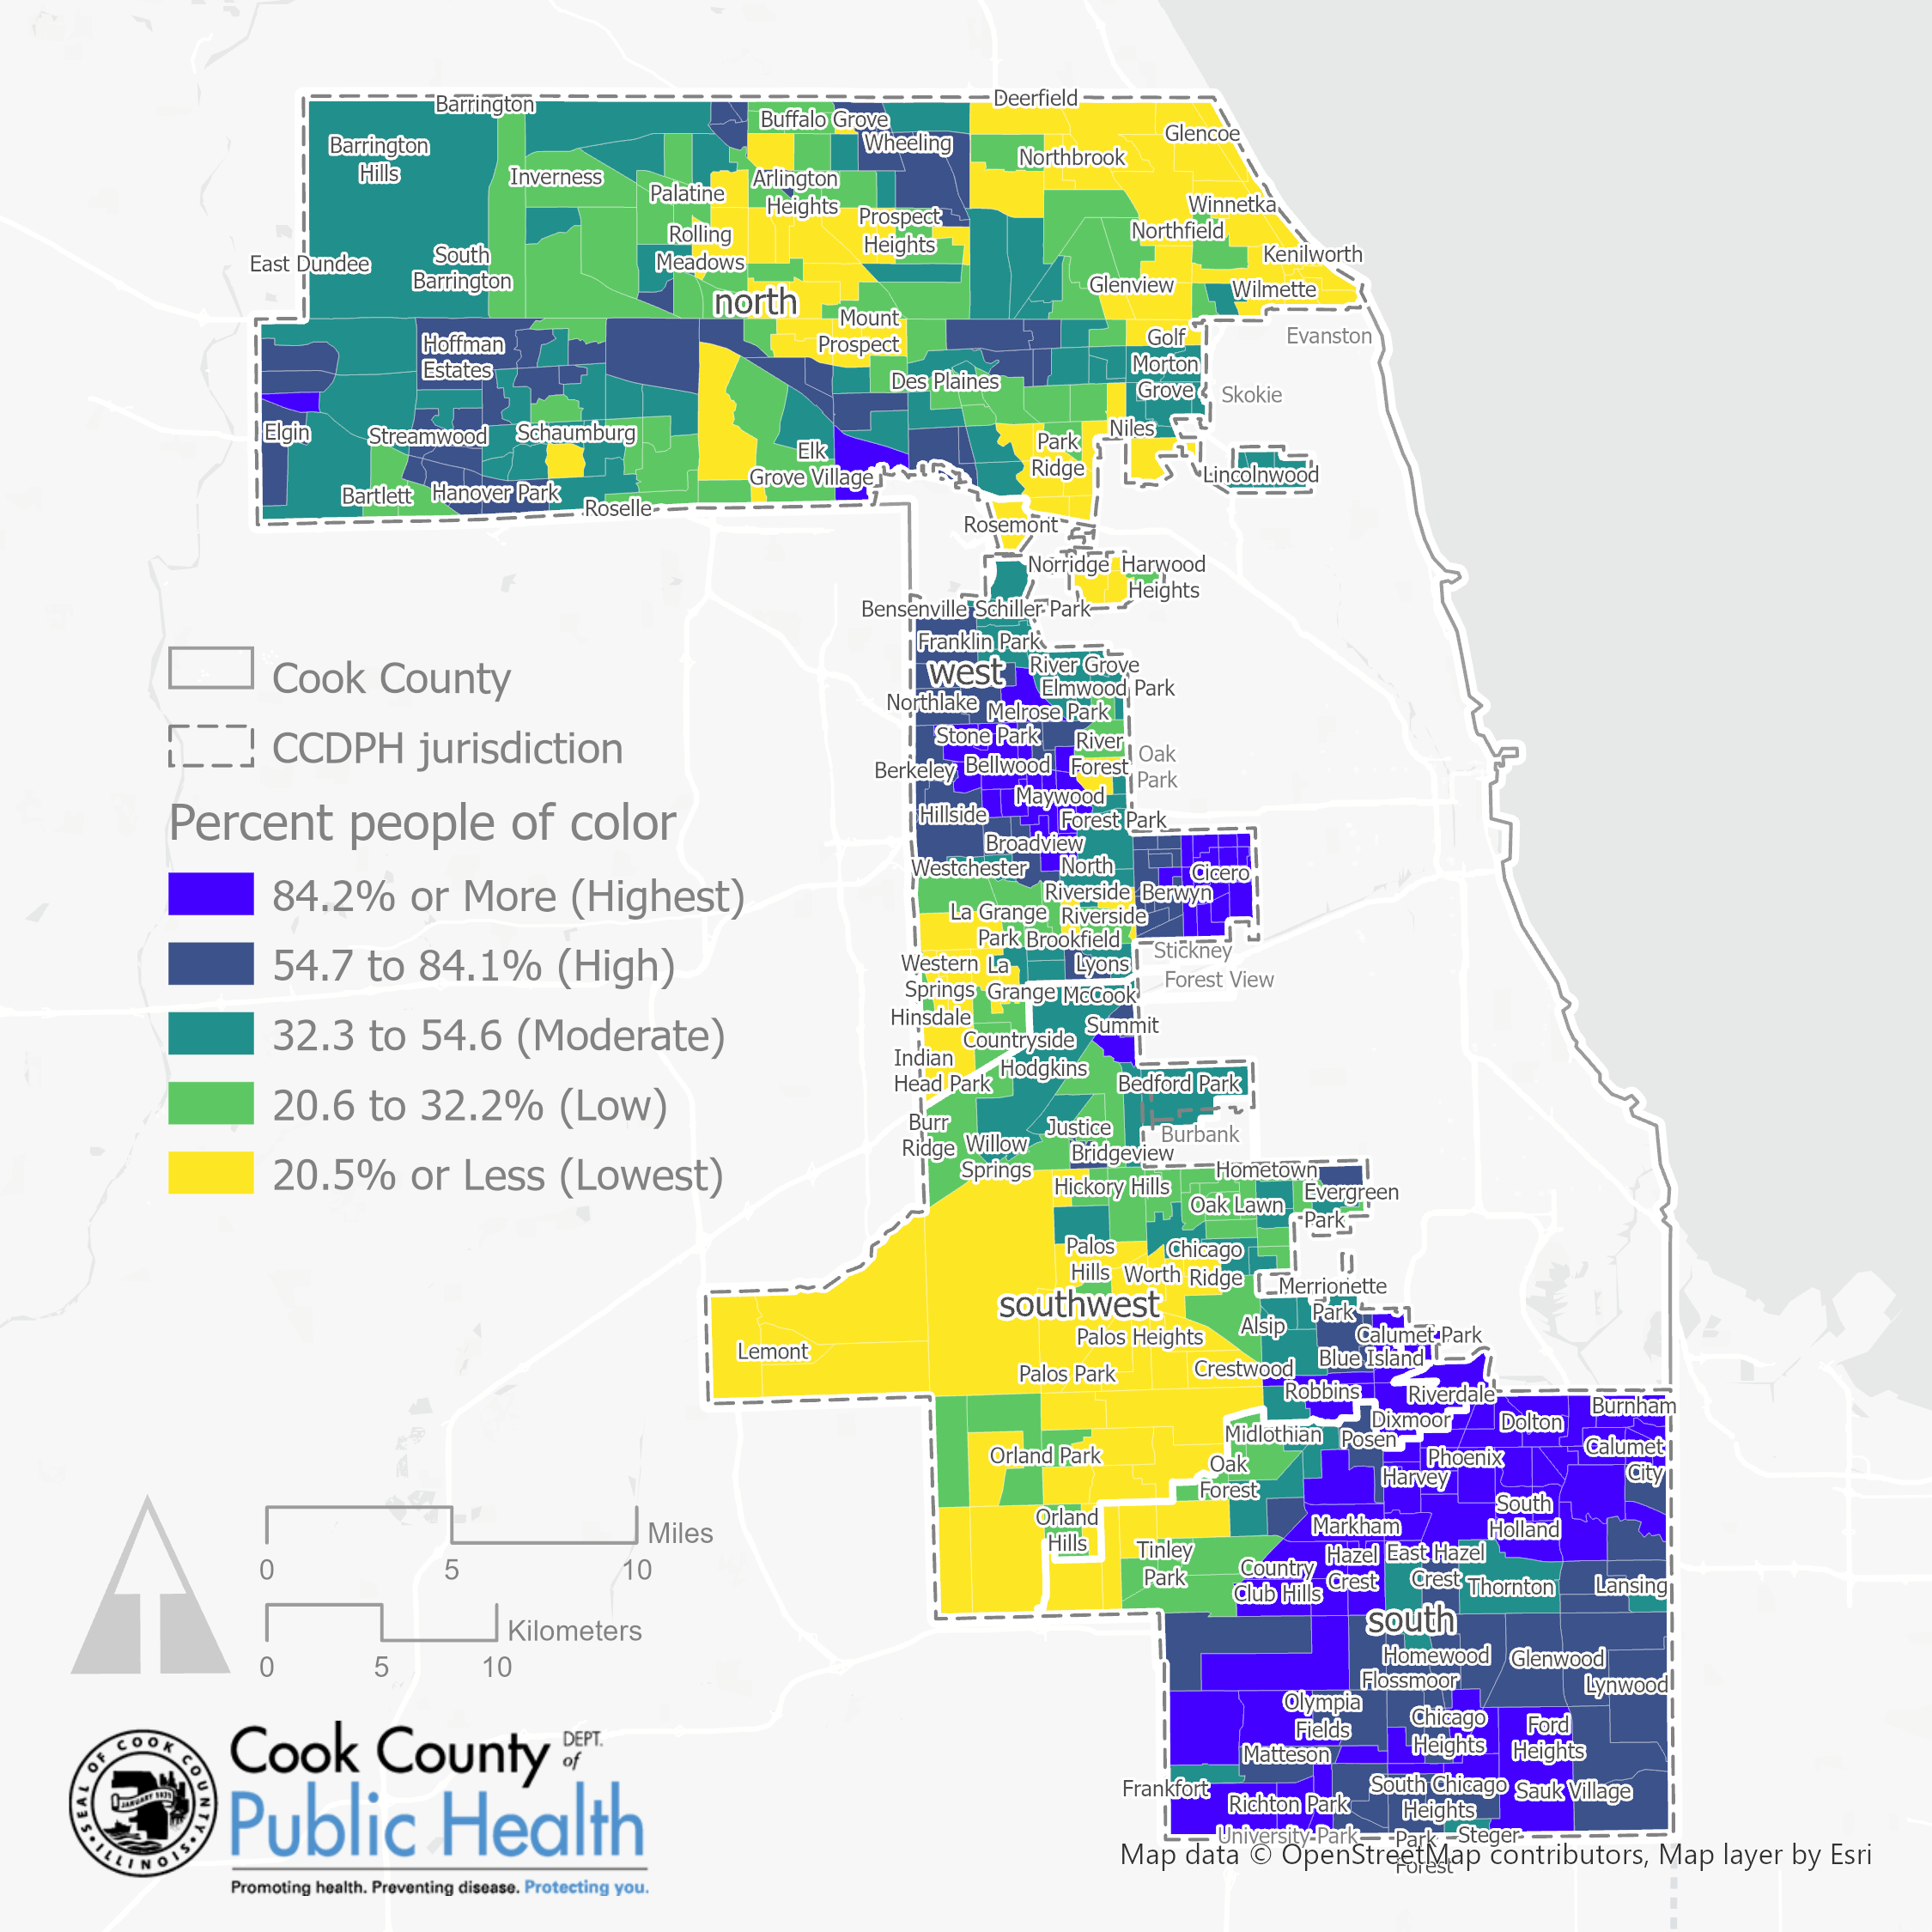
PEOPLE OF COLOR by census tract
CCDPH ‘s jurisdiction is becoming more racially and ethnically diverse:
People of color (48.3%)
Latinx (22.0%)
Asian (7.6%)
Black , not Latinx (16.8%),
White, not Latinx (51.7%)
CCDPH ‘s jurisdiction is also residentially segregated across neighborhoods and districts. Percentage of people of color by CCDPH district.
South (70.7%)
West (58.7%)
North (36.9%)
Southwest (33.5%)
Data sources: US Census Bureau American Community Survey, 2015-2019 Table B03002, Hispanic or Latino Origin by Race; TIGER/Line shapefiles, 2019

Slide 7
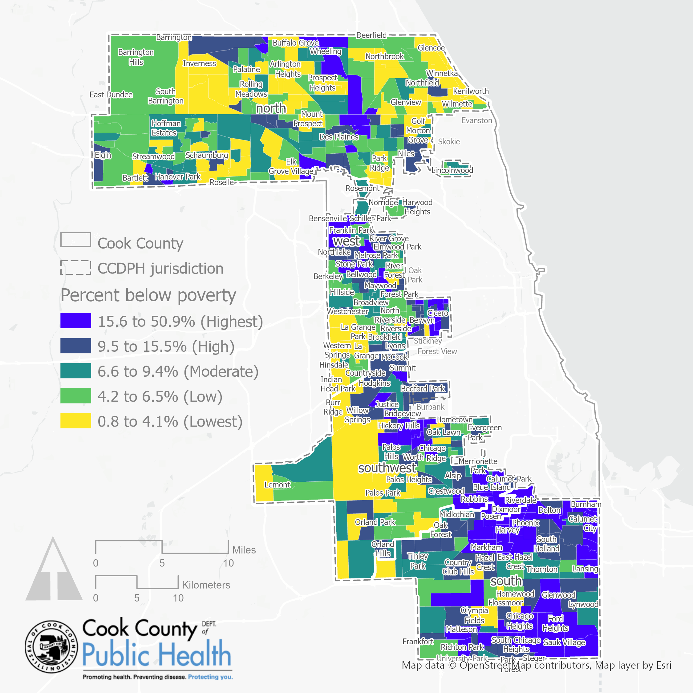
Poverty rate by census tract
The US Census Bureau set the 2019 poverty threshold for a family of four at $26,172 .
Approximately 14.4% of the population in Cook County earned below the poverty threshold in 2019 and 10.0% within CCDPH’s jurisdiction.
Poverty rates vary geographically. Below are rates by CCDPH district ordered from highest to lowest:
South (15.6%),
West (10.5%)
Southwest (10.4%)
North (6.7%)
Data sources: US Census Bureau American Community Survey, 2015-2019 Table B17001, Poverty Status in the Past 12 Months by Sex by Age; TIGER/Line shapefiles, 2019

Slide 8
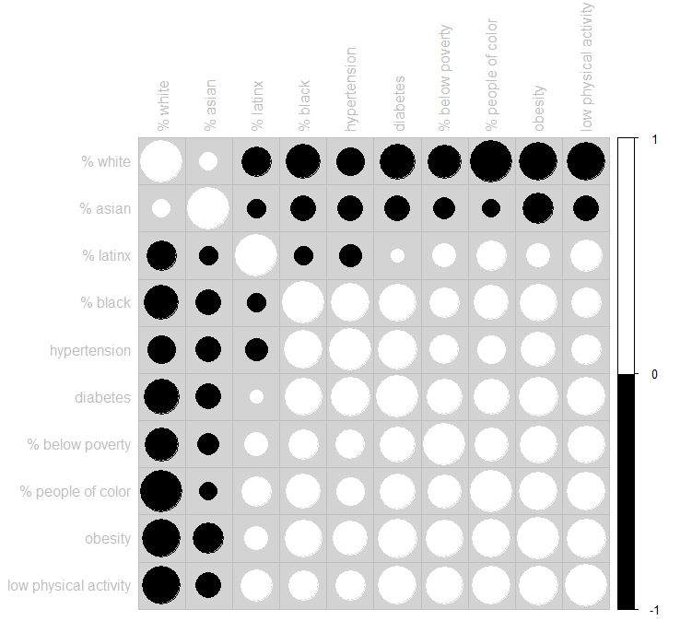
Measuring inequities
Statistical relationships exist between race, ethnicity, income and health outcomes.
Percentage of people of color is positively correlated with prevalence of hypertension, obesity and low recreational physical activity. Whereas percentage white, not Latinx tends to be strongly negatively correlated with these variables.
Poverty rates also tend to be highly correlated with poor health outcomes.
What policies, systems and environments create these inequities?
WHY?
N=470 census tracts. All bivariate correlations are statistically significant (p<=0.01)
Notes:
Description
This figure shows a correlogram which graphs the bivariate Pearson product-moment correlation coefficients between select race, ethnic, income, health outcome and healthy behavior variables by census tract located within CCDPH’s jurisdiction (N=470). Numerically, the Pearson coefficient ranges from -1 to +1. A value of +1 is the result of a perfect positive relationship between two or more variables. Positive correlations, represented with white font/circles, indicate that both variables move in the same direction. Conversely, a value of -1 represents a perfect negative relationship. Negative correlations, represented with black font/circles, indicate that as one variable increases, the other decreases; they are inversely related. A zero indicates no correlation. All correlations presented are statistically significant (p<=0.01).

Slide 9
Project context community assets & partnerships
SUMMARY OF RESOURCES, PP4H NETWORKS, CCDPH PROGRAMS
Sometimes we focus on the problem and fail to highlight existing and growing assets.
Quinn Community Center—from abandoned school with a broken window to the thriving heart of the community.
Giving Garden—from a vacant lot to a food justice movement across nine gardens.
Church partners, internships, career development are part of our network and activities
Notes:
incorporate Lena’s slides
people not programs; relational
There is so much untapped potential in community
To address SDoH

Slide 10
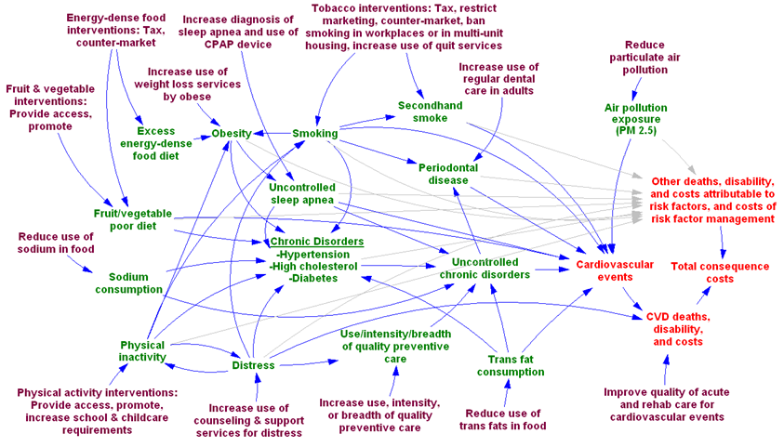

Prism framework
Notes:
Mapping the movement between intervention and impact
Touching the lives of individuals
Understanding impact is important

Slide 11
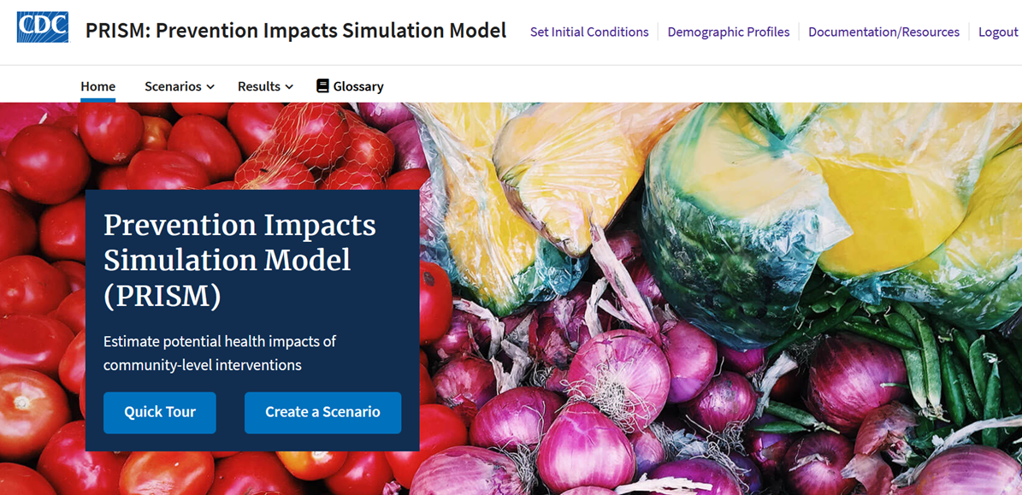
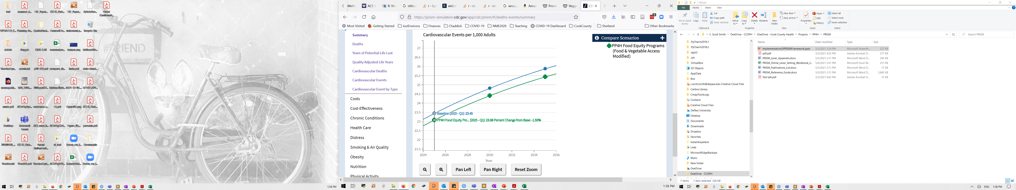
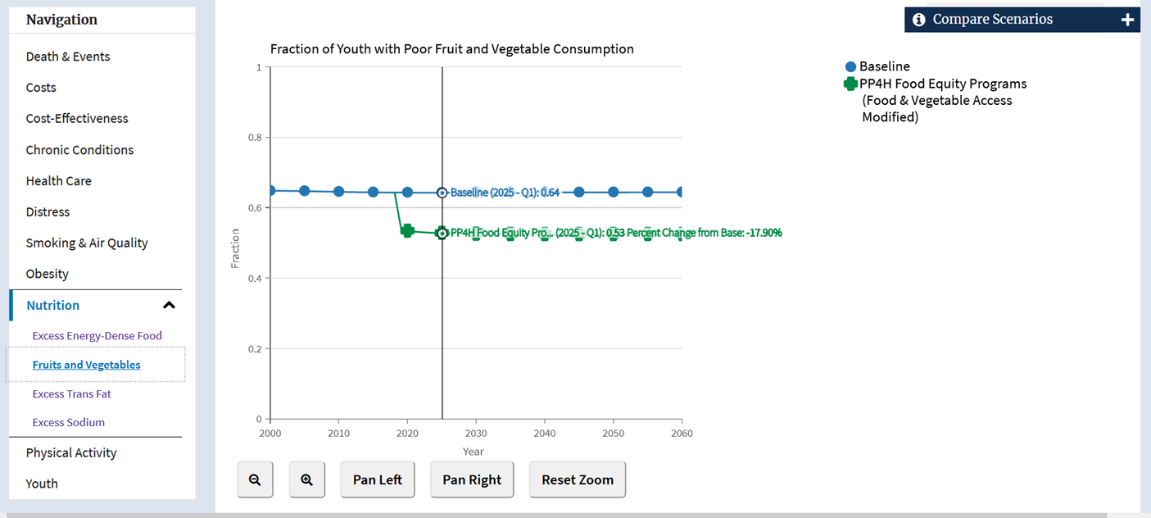
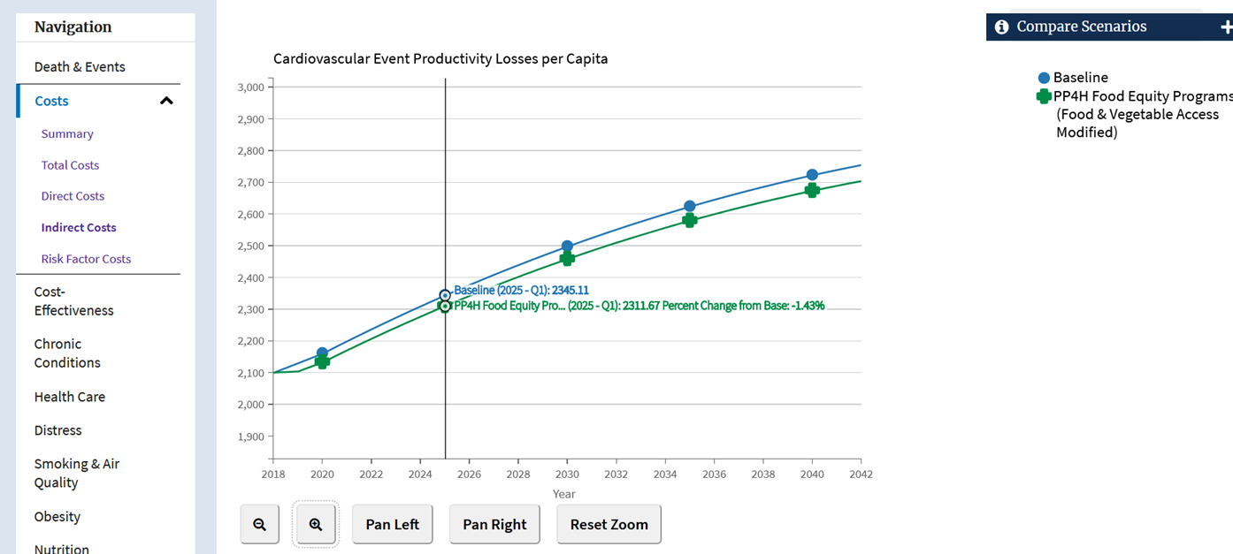
Prism SIMULATIONS

Slide 12
implications…

Slide 13
Next steps…

